Slide 3
Application of Schrodinger Wave Equation
The Schrodinger equation is used to find the allowed energy levels of quantum mechanical systems (such as atoms).
The associated wavefunction gives the probability of finding the particle at a certain position.

Slide 4
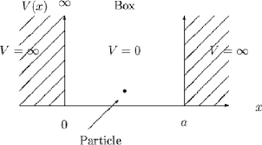
Particle in a One-Dimensional Deep Potential Well

Slide 5
Particle in a One Dimensional Deep Potential Well

Slide 6
Particle in a One Dimensional Deep Potential Well

Slide 7
Particle in a One Dimensional Deep Potential Well

Slide 8
Particle in a One Dimensional Deep Potential Well

Slide 9
Particle in a One Dimensional Deep Potential Well

Slide 10

Particle in a One Dimensional Deep Potential Well
Consider a particle of rest mass m_{o} enclosed in a one-dimensional
box (infinite potential well). Boundary conditions for Potential
V = ∞
V = ∞
0 for 0 < x < L
∞
{
V(x)=
particle
for 0 > x > L
Boundary conditions for ψ
V = 0
{
0 for x = 0
0 for x = L
x = 0
x = L
Ψ =
Thus for a particle inside the box Schrodinger equation is
(i)
∴V = 0 inside

Slide 11
₌ 2π
λ = ^{h}
(k is the propagation constant)
p
k
Equation (i) becomes
∂²ψ
(ii)
+ k ψ = 0
2
(iii)
∂x²
General solution of equation (iii) is
ψ (x) = Asin kx + B cos kx
(iv)

Slide 12
ψ (0) = Asin k.0 + B cos k.0
Boundary condition says ψ = 0 when x = 0
0 = 0 + B.1 ⇒ B = 0
Equation (iv) reduces to
ψ (x) = Asin kx
Boundary condition says ψ = 0 when x = L
ψ (L) = Asin k.L
0 = Asin k.L
(v)
A ≠ 0 ⇒ sin k.L = 0
⇒ sin k.L = sin nπ

Slide 13
kL = nπ
_{k =} nπ
L
Put this in Equation (v)
ψ (x) = Asin
(vi)
nπx
L
When n # 0 i.e. n = 1, 2, 3…., this gives ψ = 0 everywhere. Put value of k from (vi) in (ii)

Slide 14
_{n}2 _{h}2
Energy of the particle inside well
=
8m L²
(vii)
o
Where n = 1, 2, 3…. quantum numbers
Equation (vii) concludes
1. Energy of the particle inside the box can’t be equal to zero.
The minimum energy of the particle is obtained for n = 1
_{h}2
(Zero Point Energy)
^{E1 =} 8m L²
o
If
E₁ → 0 momentum → 0 i.e. Δp → 0
⇒ Δx → ∞
since the particle is confined in the box of
But
x_{max} = L
dimension L.
Δt

Slide 15
Thus zero value of zero point energy violates the Heisenberg’s uncertainty principle and hence zero value is not acceptable.
All the energy values are not possible for a particle in potential well.
Energy is Quantized
E_{n} are the eigen values and ‘n’ is the quantum number.
Energy levels (E_{n}) are not equally spaced.
E₃
E₂
n = 3
n = 2
n = 1
E
1

Slide 16
ψ (x) = Asin ^{nπx}
To evaluate A we can use normalized condition
n
L
Using Normalization condition
∞
2
∫|ψ _{n} (x) | dx = 1
−∞
L
nπx
A² ∫sin ² dx = 1
L
0
2
⎜ ₂ ⎟
A^{2 ⎛ L ⎞} = 1 ⇒ A =
⎝ ⎠
L
The normalized eigen function of the particle are
2 _{sin} πnx L L
ψ (x) =
n
ψ Wave functions and corresponding energies E_{n} , which are often called eigen function and eigen values respectively, describes the quantum state of the particle.
n

Slide 17
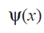
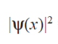
The electron wave function and the corresponding probability density functions
for the ground and first two excited states of an electron in a potential well, are shown in figure

Slide 18
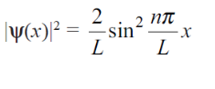
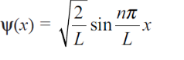

Slide 19
Probability density figure suggest that:
There are some positions (nodes) in the box that will never be occupied by the particle.
For different energy levels the points of maximum probability are found at different positions in the box.
|ψ₁|² is maximum at L/2 (middle of the box)
|ψ₂|² is zero L/2.
The energy is quantized and so it cannot vary continuously.
The probability of finding electron in the first energy level is maximum at the Center of the well.
But in the second energy level it is zero at the center of the well.
Thus in each energy level, the location of finding the electron is different

Slide 20
E = E_{x} + E_{y} + E_{z}
Particle in a Three Dimensional Box
Eigen energy
_{h}2
2
2
2
E = (n +
n + n )
x
y
z
8mL
2
Eigen function
ψ =ψ _{x}ψ _{y}ψ _{z}
n πx
n πy
n πz
ψ = A A A sin
x
sin
y
sin
z
x y z
L
L
L
_{2 ⎞}3
⎛
n πx
n πy
n πz
ψ = ⎜ ⎟ sin ^{x} sin ^{y} sin ^{z}
⎝
L ⎠ L
L
L

Slide 23
FINITE POTENTIAL WELL
Potential energies are never infinite in the real world, and the box with infinitely hard walls of the previous section has no physical counterpart.
However, potential wells with barriers of finite height certainly do exist.
Let us see what the wave functions and energy levels of a particle in such a well are.
Figure shows a potential well with square corners that is U high and L wide and contains a particle whose energy E is less than U.
In quantum mechanics, the particle also bounces back and forth, but now it has a certain probability of penetrating into regions I and III even though E < U.
In regions I and III Schrödinger’s steady-state equation is

Slide 24
FINITE POTENTIAL WELL

Slide 25
FINITE POTENTIAL WELL

Slide 26
FINITE POTENTIAL WELL

Slide 27
FINITE POTENTIAL WELL

Slide 28
FINITE POTENTIAL WELL

Slide 33
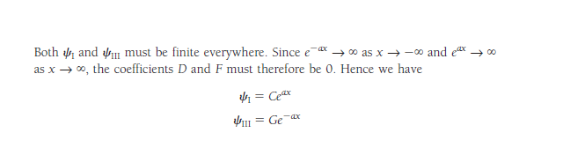
These wave functions decrease exponentially inside the barriers at the sides of the well.

Slide 34
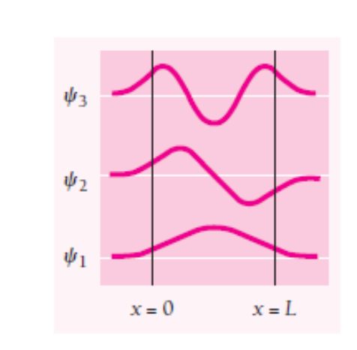
Within the well Schrödinger’s equation is the same as above Eq. and its solution is again
(1)
In the case of a well with infinitely high barriers, we found that B = 0 in order that
Ψ=0 at x = 0 and x = L.
Here, however, Ψ_{II} =C at x =0 and Ψ_{II} =G at x =L,
so both the sine and cosine solutions of Eq. (1) are possible.

Slide 35
For either solution, both Ψ and (d Ψ /dx )must be continuous at x =0 and x= L:
The wave functions inside and outside each side of the well must not only have the same value where they join but also the same slopes, so they match up perfectly.
When these boundary conditions are taken into account, the result is that exact matching only occurs for certain specific values E_{n} of the particle energy.
The complete wave functions and their probability densities are shown in Fig
Wave functions and probability densities of a particle in a finite potential well.
The particle has a certain probability of being found outside the wall

Slide 37
Because the wavelengths that fit into the well are longer than for an infinite well of the same width, the corresponding particle momenta are lower (we recall that λ= h/p).
Hence the energy levels E_{n} are lower for each n than they are for a particle in an infinite well.

Slide 41
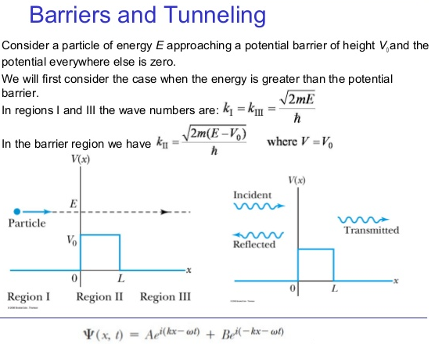

Slide 42
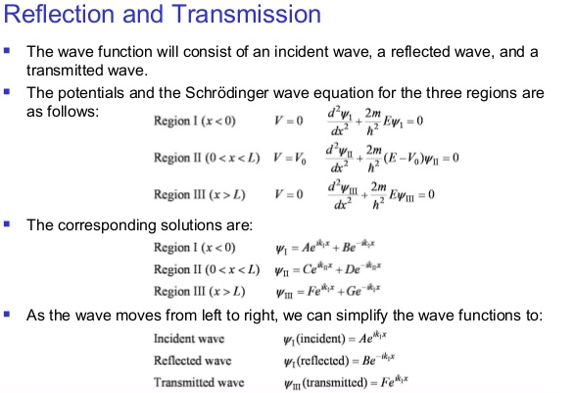

Slide 43
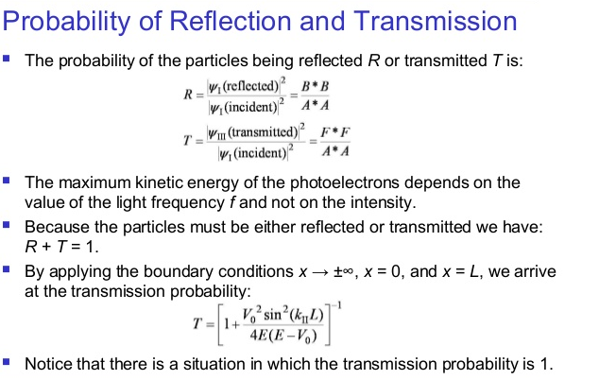

Slide 44
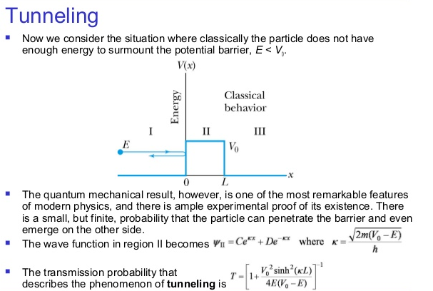

Slide 45
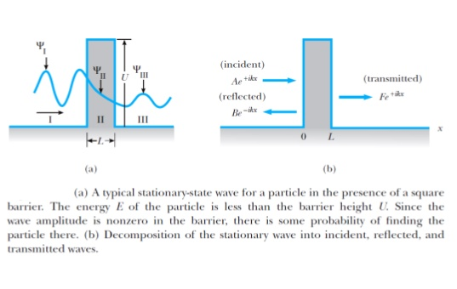

Slide 46

Tunneling & Microchip Development
As microchip developers create smaller production processes, we reach the limit of classical computer technology
The feature size of the most advanced microchip today is 45 nm
With such small widths, the electrons in the channel can tunnel out with relative ease, possibly affecting other transistors in the chip
Current approximations show that the minimum feature size is about 4 nm
After that point tunneling is not only possible, but highly likely and the chip would fail

Slide 47
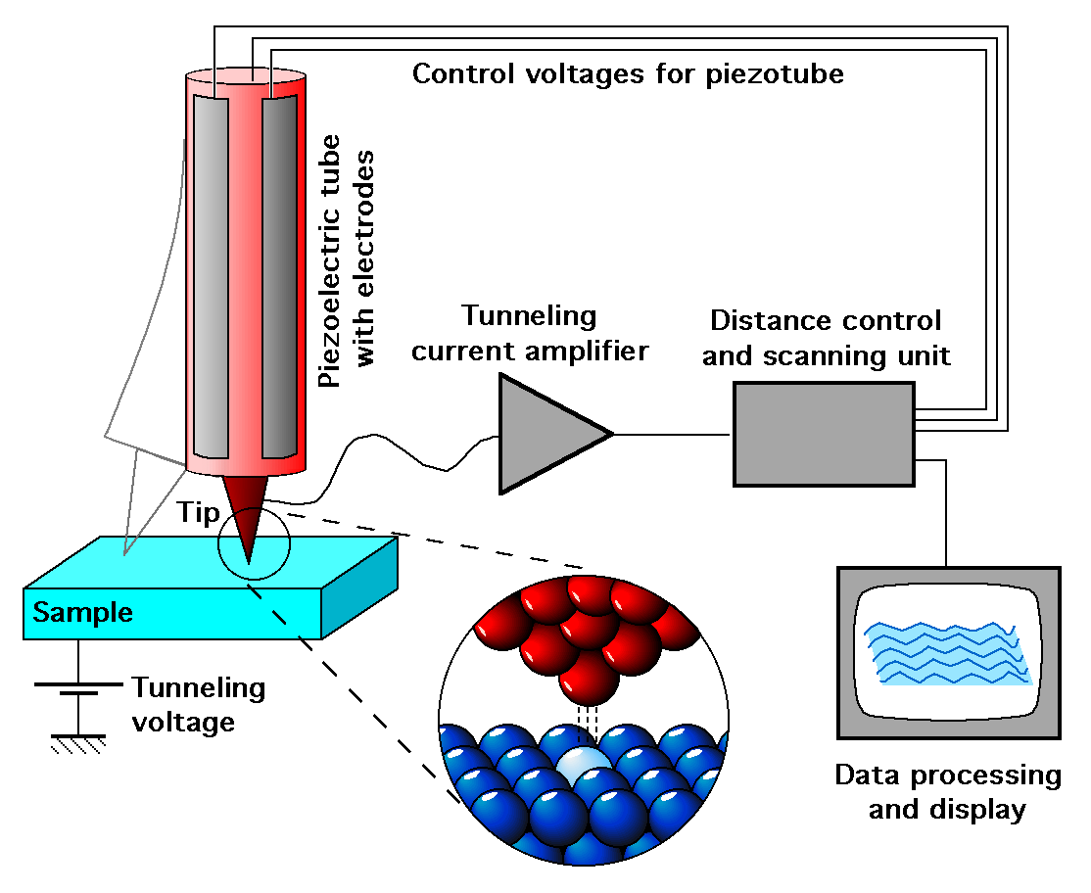

Scanning Tunneling Microscopes
The Scanning Tunneling Microscope was invented in 1981 by Gerd Binnig and Heinrich Rohrer
When a metal tip, usually made of tungsten or platinum-iridium, is brought within .4-.7nm of the sample, electrons tunnel across the gap and create a current in the tip
This current is then fed to a computer and used to generate an image of the atomic surface of the sample
Image courtesy of Wikipedia

Slide 48
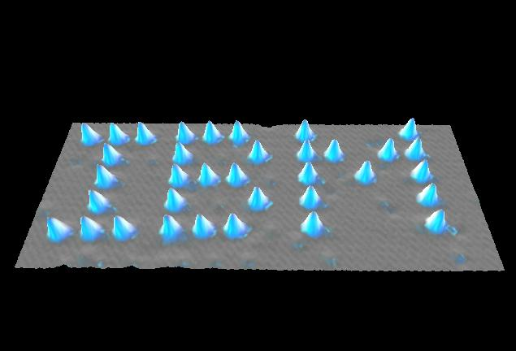
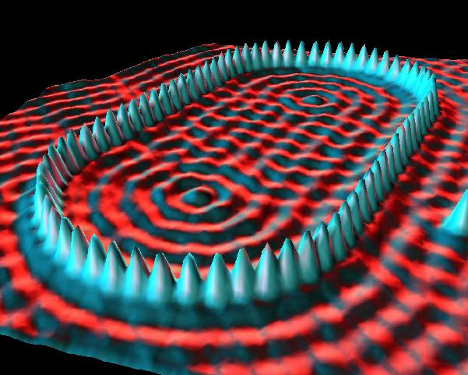
At this distance the coulomb force between the tip and an atom of the sample is actually enough to move the atom
This has allowed physicists to create images and structures on the atomic level
Images courtesy of IBM

Slide 51
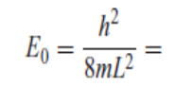
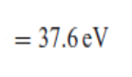

Slide 53

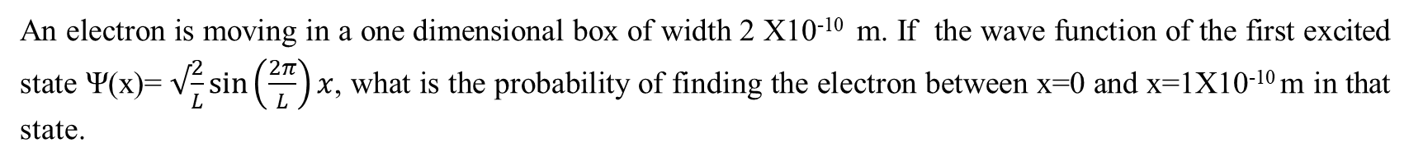
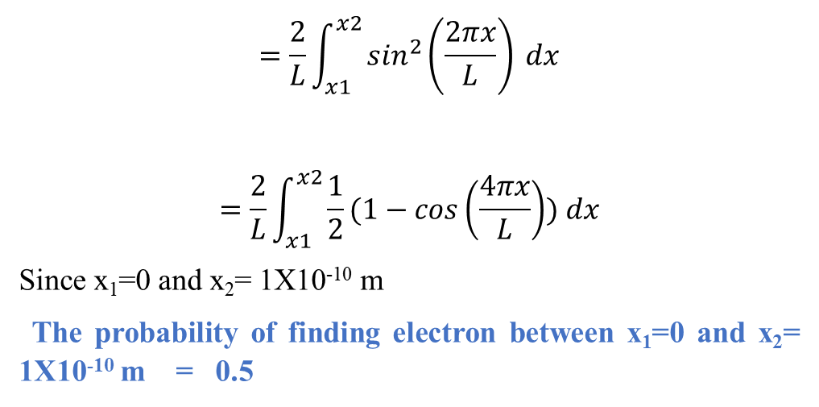
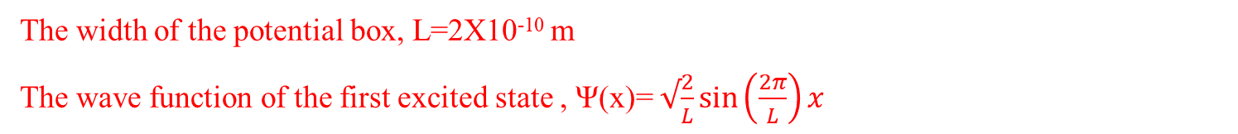
An electron is moving in a one dimensional box of width 2 X10⁻¹⁰ m. If the wave function of the first excited state Ψ(x)= $√\frac{2}{L}\sin\left(\frac{2π}{L}\right)x$, what is the probability of finding the electron between x=0 and x=1X10⁻¹⁰ m in that state.
The width of the potential box, L=2X10^{‑10} m
The wave function of the first excited state , Ψ(x)= $√\frac{2}{L}\sin\left(\frac{2π}{L}\right)x$
The required probability, =$\int_{x1}^{x2}{{|Ψ\left(x\right)|}^{2}} dx$
$$=\frac{2}{L}\int_{x1}^{x2}{\sin^{2}\left(\frac{2πx}{L}\right)} dx$$
$$=\frac{2}{L}\int_{x1}^{x2}{\frac{1}{2}(1−cos\left(\frac{4πx}{L}\right)}) dx$$
Since x₁=0 and x₂= 1X10^{‑10} m
The probability of finding electron between x₁=0 and x₂= 1X10^{‑10} m = 0.5

Slide 54
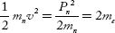
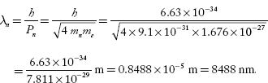
Calculate the de Brogile wavelength of neutron whose kinetic energy is two times the rest mass of electron (given m_{n} = 1.676 × 10^{–27} kg, m_{e} = 9.1 × 10^{–31} kg, C = 3 × 10 ⁸ m/s and h = 6.63 × 10^{–34} J.S).
Kinetic energy of neutron
where m_{n} = mass of neutron
m_{e} = mass of an electron
de Brogile wavelength of neutron, λ_{n} = ?

Slide 55
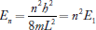
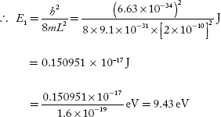
An electron is confined to a one-dimensional potential box of length 2 Å. Calculate the energies corresponding to the second and fourth quantum states (in eV).
Length of the one-dimensional potential box, L = 2Å = 2 × 10^{–10} m
Energy of electron in nth level,
Energy corresponding to second and fourth quantum states is:
E₂ = 2²E₁ = 4 × 9.43 eV = 37.72 eV
and
E₄ = 4²E₁ = 16 × 9.43 eV = 150.88 eV

Slide 56
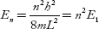
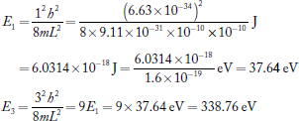
Calculate the energy required to pump an electron from ground state to the 2nd excited state in a metal of length 10^{–10} m.
The energy of an electron of mass ‘m’ in nth quantum state in a metal of side ‘L’ is:
n = 1, corresponds to ground state
n = 2, corresponds to first excited state and
n = 3, corresponds to second excited state

Slide 57
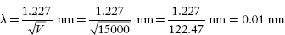
An electron is moving under a potential field of 15 kV. Calculate the wavelength of the electron waves.
V = 15 × 10³ V λ = ?

